Slide 1
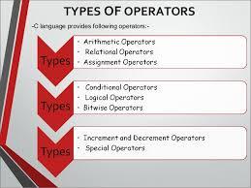
EVOCATION

Slide 2
OPERATORS AND EXPRESSIONS

Slide 3
General objective
Students will be able to understand the operators in C.

Slide 4
Specific objectives
List the five arithmetic operators in C.
List the six relational operators in C.
List the three logical operators in C.
List the eleven assignment operators in C.

Slide 5
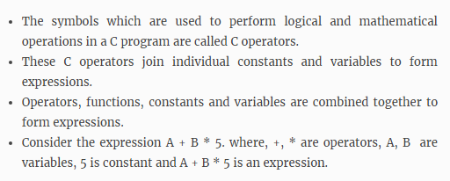
C-operators and expressions

Slide 6
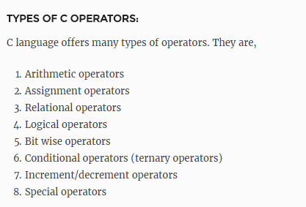

Slide 7
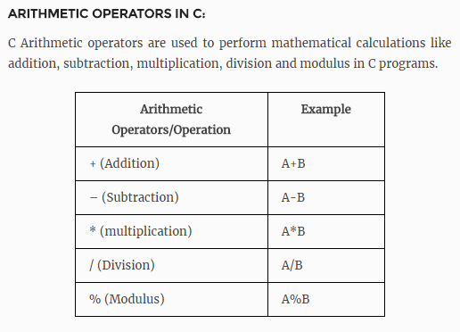

Slide 8
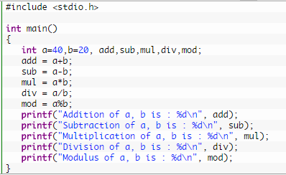

Slide 9
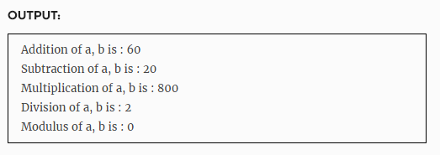

Slide 10
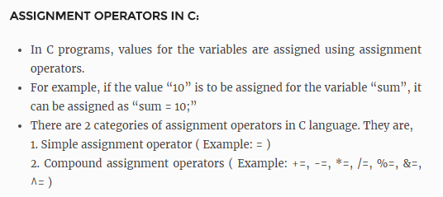

Slide 11
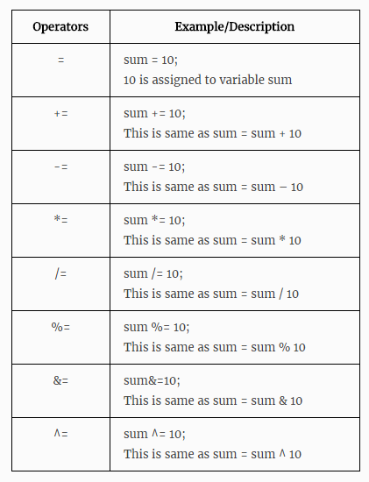

Slide 12
#include<stdio.h>
void main()
{
int total,i=2;
total+=i;
printf(“%d”, total);
getch();
}
Output:
3

Slide 13
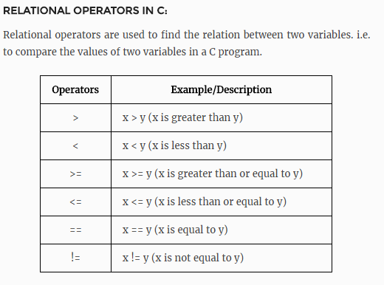

Slide 14
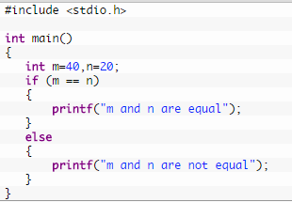


Slide 15
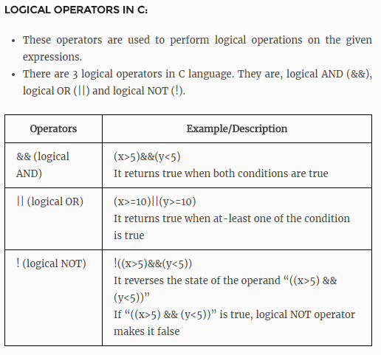

Slide 16
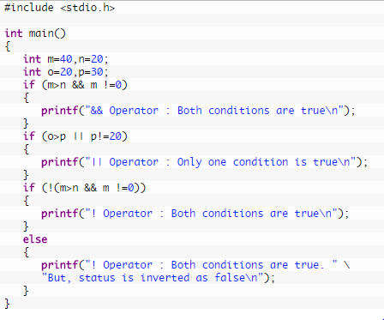

Slide 17
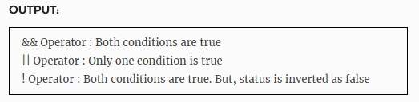

Slide 18
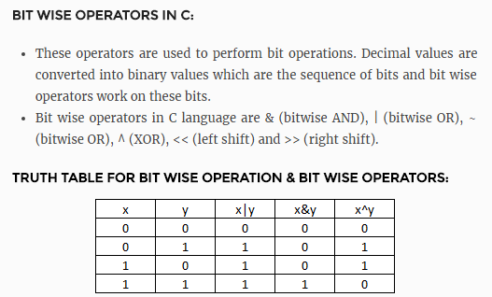

Slide 19
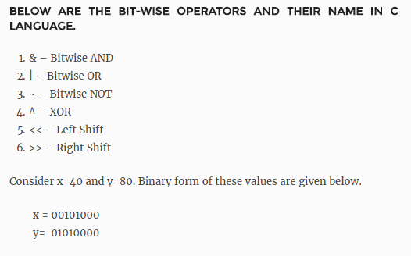

Slide 20
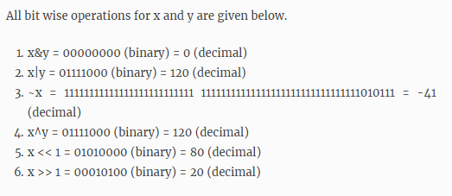
1

Slide 21
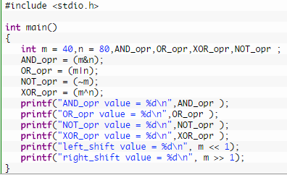

Slide 22
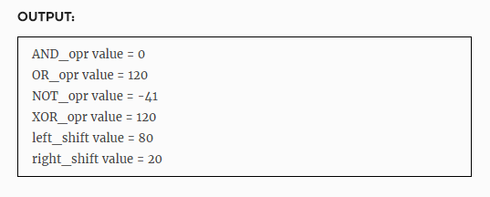

Slide 23
Assignment operators
Syntax:
v = exp;
Where
v is a variable,
exp = expression
Ex: x=x+3

Slide 24
Shorthand Assignment operators
Simple assignment operator | Shorthand operator
a = a+1 | a + =1
a = a-1 | a - =1
a = a* (m+n) | a * = m+n
a = a / (m+n) | a / = m+n
a = a %b | a %=b

Slide 25
Increment & Decrement Operators
C supports 2 useful operators namely
Increment ++
Decrement --
The ++ operator adds a value 1 to the operand
The -- operator subtracts 1 from the operand
Ex: ++a or a++
--a or a--

Slide 26
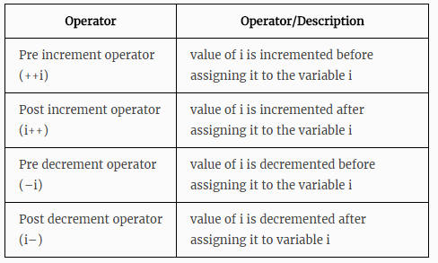

Slide 27
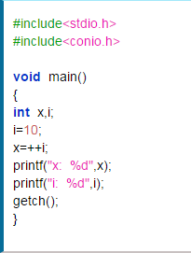

Pre-increment

Slide 28
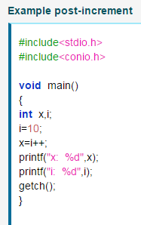
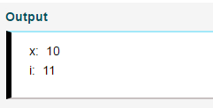

Slide 29
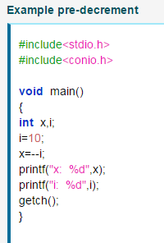
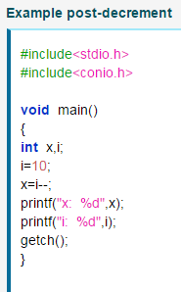

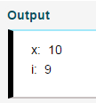

Slide 30
Example: Increment & Decrement
#include <stdio.h>
#include <conio.h>
void main()
{
int c=2,d=4, e=5, f=6;
clrscr();
printf("%d\n",c++); // displays 2 then, only c incremented by 1
printf("%d\n",c);
printf("%d",++d); // increments 1 to d then, only d is displayed
printf("%d\n“,e--); // displays 5 then, only e decremented by 1
printf("%d\n",e);
printf("%d",--f); // decrements1 from f then, only f is displayed
getch();
}

Slide 31
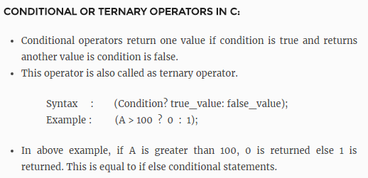

Slide 32
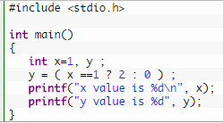
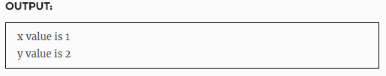

Slide 33
Special operators
Comma operator ( ,)
sizeof operator – sizeof( )
Pointer operators – ( & and *)
Member selection operators – ( . and ->)

Slide 34
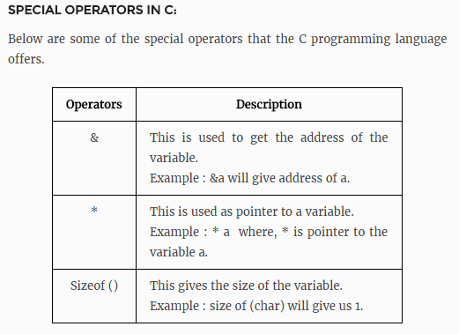

Slide 35
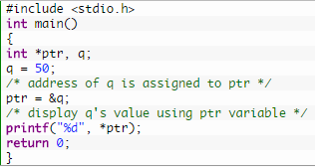


Slide 36

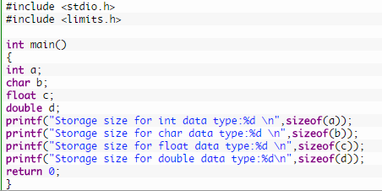

Slide 37
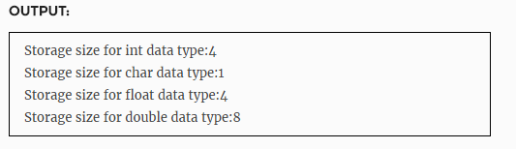

Slide 38
Expression
An expression is a combination of variables constants and operators written according to the syntax of C language.
In C every expression evaluates to a value i.e., every expression results in some value of a certain type that can be assigned to a variable.
example:
int a,b,c;
a = 5;
b = 6;
c = a + b ;

Slide 39
Typical Precedence Levels( highest to lowest)
Parentheses
Unary operators
** (exponentiation, if the language supports it)
*, /, % (modulo)
+, -

Slide 40
Precedence & Associativity of Operators
Precedence | Operator | Description | Associativity
1 | () [] -> . ++ -- | Grouping operator Array access Member access from a pointer Member access from an object Post-increment Post-decrement | left to right
2 | ! ~ ++ -- - + & (type) sizeof | Logical negation Bitwise complement Pre-increment Pre-decrement Unary minus Unary plus Address of Cast to a given type Return size in bytes | right to left

Slide 41
Precedence & Associativity of Operators
Precedence | Operator | Description | Associativity
3 | * / % | Multiplication Division Modulus | left to right
4 | + - | Addition Subtraction | left to right
5 | << >> | Bitwise shift left Bitwise shift right | left to right
6 | < <= > >= | Comparison less-than Comparison less-than-or-equal-to Comparison greater-than Comparison greater-than-or-equal-to | left to right

Slide 42
Precedence & Associativity of Operators
Precedence | Operator | Description | Associativity
7 | == != | Comparison equal-to Comparison not-equal-to | left to right
8 | & | Bitwise AND | left to right
9 | ^ | Bitwise exclusive OR | left to right
10 | | | Bitwise inclusive (normal) OR | left to right
11 | && | Logical AND | left to right
12 | || | Logical OR | left to right
13 | ? : | Ternary conditional (if-then-else) | right to left

Slide 43
Precedence & Associativity of Operators
Precedence | Operator | Description | Associativity
14 | = += -= *= /= %= &= ^= <<= >>= | Assignment operator Increment and assign Decrement and assign Multiply and assign Divide and assign Modulo and assign Bitwise AND and assign Bitwise exclusive OR and assign Bitwise shift left and assign Bitwise shift right and assign | right to left

Slide 44
Example 1
Evaluate x1=(-b+ sqrt (b*b-4*a*c))/(2*a) @ a=1, b=-5, c=6
=(-(-5)+sqrt((-5)(-5)-4*1*6))/(2*1)
=(5 + sqrt((-5)(-5)-4*1*6))/(2*1)
=(5 + sqrt(25 -4*1*6))/(2*1)
=(5 + sqrt(25 -4*6))/(2*1)
=(5 + sqrt(25 -24))/(2*1)
=(5 + sqrt(1))/(2*1)
=(5 + 1.0)/(2*1)
=(6.0)/(2*1)
=6.0/2 = 3.0

Slide 45
Example 2
Evaluate the expression when a=4
b=a- ++a
=a – 5
=5-5
=0

Slide 46
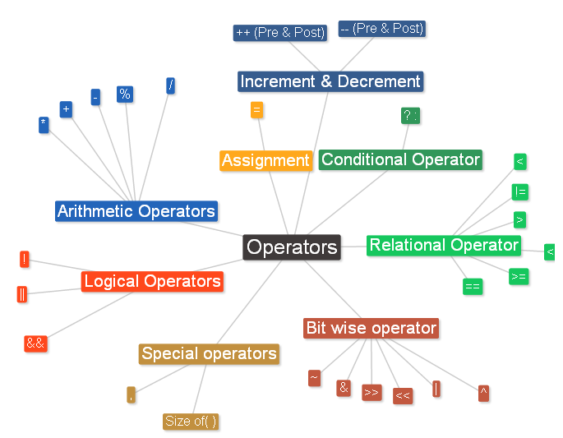
Mind map

Slide 47
Stimulating question
Is it possible to use relational and arithmetic operator in a same expression?

